Slide 1
Thank you for joining!
We will begin momentarily. Please note today’s meeting will be recorded.

Slide 2
CODI National Collaborative
November 16, 2022

Slide 3
Agenda
Topic | Time | Presenter
Welcome | 5 min | CDC
CODI overview | 10 min | CDC
CODI Colorado highlights | 15 min | Colorado Health Institute
CODI North Carolina highlights | 15 min | Duke University
Discussion | 10 min | All
Closing remarks | 5 min | CDC
Notes:
Discussion: feedback, what are their questions, sustainability solutions – what ideas do you have for facilitating sustainability for the two sites? What are sustainability solutions for networks and initiatives such as these at local, state level? What sustainability approaches could be considered for CODI sites?

Slide 4

Purpose of the National Collaborative
Share updates on CODI site progress
Connect and engage stakeholders
Discuss opportunities for sustainability and support

Slide 5
Thank you for joining
National/Government | Health Systems & Academia | Colorado | North Carolina
Centers for Disease Controls & Prevention Centers for Medicare & Medicaid Services American Academy of Pediatrics National Association for Community Health Centers Office of the National Coordinator University of Texas Department of Agriculture National Institutes of Health Amazon Web Services Girls on the Run Kellogg Foundation National Association of Chronic Disease Directors American Heart Association Robert Wood Johnson Foundation Administration for Community Living Parks & Recreation National Office Agency for Healthcare Research & Quality Freedmen’s Health | Brown University George Washington University Yale University Massachusetts General Hospital for Children Children's Hospital at Vanderbilt Kaiser Permanente Pennington The New York Academy of Medicine Wake Forest University Washington University University of Western Michigan Children’s Hospital of Philadelphia | Children’s Hospital of Colorado Colorado Health Foundation Denver YMCA Denver Health and Hospital Authority Girls on the Run of the Rockies Hunger Free Colorado Cooking Matters Supplemental Nutrition Program for Women, Infants, and Children Colorado Department of Public Health and Environment | Integrated Care for Kids Duke University University of North Carolina YMCA of the Triangle Durham County Department of Public Health Parks & Recreation Health Information Exchange NC Department of Health & Human Services NC Association of Free Clinics NC Longitudinal Data Systems Health Eating Research Network NC Longitudinal Data Systems
Notes:
Project Scope
To aid our clinical, community, research, and public health partners
To address information to inform public health and health service research, surveillance, and evaluation
Collectively Developed a series of use cases and scenarios with data providers to understand their current and future obesity work flow and information needs
We want to understand things like
To understand when obesity screening is occurring and the action it triggers
To assess and compare the effectiveness of clinical and community interventions
To address gaps in obesity surveillance
To address gaps in social services and target limited resources
We want to understand things like
To understand when obesity screening is occurring and the action it triggers
To assess and compare the effectiveness of clinical and community interventions
To address gaps in obesity surveillance and target limited resources
To understand the information needs of our partners for obesity research and surveillance, community health, evaluation, and QI

Slide 6
CODI Overview

Slide 7
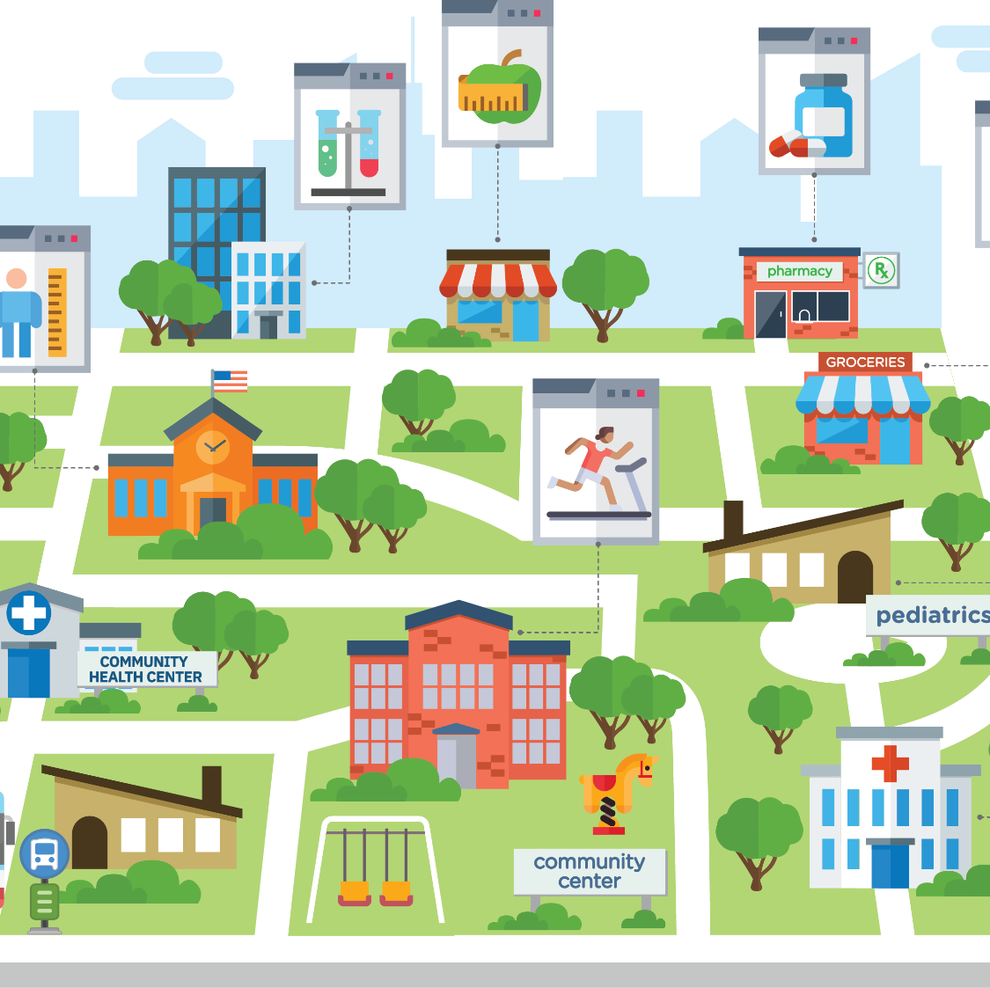
Challenge: Clinical-Community Interoperability
Issues
  Disparate data & systems
  Information sharing
Data problem to address
  Organizational interoperability
  Infrastructure for linked longitudinal data across programs, settings & systems
  Privacy & security

Slide 8



What CODI aims to achieve
Community Health
Evaluation & QI
Research & Surveillance
Clinics:​ Improve understanding of which clinical or community programs are effective for which patients
Community Partners:​ Identify & target gaps in service delivery & data on intervention effectiveness
Researchers:​ Enable comparative effectiveness studies
Public health: Improve surveillance and evaluation to help decision making
Policy Makers: Improve understanding of opportunities to improve health through strategic interventions and resource investments

Slide 9
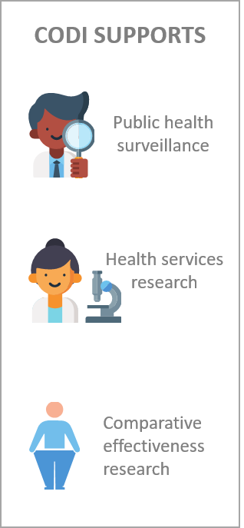









The CODI Solution
Individual- & household-level, linked longitudinal records
  Healthcare – e.g., height, weight, blood pressure
  Intervention – clinical & community weight management programs
  Determinants of health – individual & community
  Community based organization – e.g., program participation
  Administrative – e.g., payer reimbursement
Notes:
- Equity data

Slide 10








Clinical-Community Distributed Data Network
1
Program Evaluation, Surveillance,
and Research
2
3
Query
Data
Coordinating
Center
Local
Queries
TTP
Longitudinal
Records
4
5
Leverage existing infrastructure
  PCORnet and PopMedNet infrastructure
  Standardized data clinical and community data
  Privacy-preserving record linkage

Slide 11
CODI Evolution
 | CODI@Colorado | CODI@North Carolina
Participating Organizations | 3 clinical and 2 community organizations Integrated into existing network | 2 clinical and 5 community organizations Created network from scratch
Focus of the Network | Pediatric population Started with a focus on obesity SDOH | Pediatric and adult population All chronic conditions SDOH
Technology | Developed privacy preserving record linkage (PPRL) solution Longitudinal pediatric EHR height & weight data cleaning Weighted prevalence estimates by BMI category for kids | Enhanced the PPRL solution and expanded to household linkage Longitudinal adult EHR data cleaning Weighted prevalence estimates by BMI category for kids & adults and co-occurring conditions FHIR implementation guides

Slide 12
Timeline
CODI@CO pilot launch
CO development of governance agreements
CO executed queries to create longitudinal dataset
CODI@NC pilot launch
CO network expansion
NC network scoping & partner engagement
CO developing QA processes
NC governance & implementation planning
CO begin dataset analysis
NC longitudinal dataset & transition year
2018 | 2019 | 2020 | 2021 | 2022 | 2023

Slide 13
CODI Strikes (a) CHORDS:
Implementing a Clinical-Community Partnership in Colorado
Emily Bacon, PhD
Bacon Analytics; Denver Health and Hospital Authority
Nina Bastian
Colorado Health Institute
November 16, 2022
Notes:
Before I begin….this work requires a huge amount of collaboration and effort
Acknowledge the many people and organizations that have made it possible,
And the diverse skillsets involved, including programmers, project managers, executive directors of CBOs who have learned to run python scripts, and the many leaders who have championed this work
Some of the folks that are involved in this work are on the call
I am one spokesperson of many that could give this presentation today
With that being said, I’m honored to be with you

Slide 14
Overview
The journey of CODI in Colorado
Challenges, accomplishments, and learnings
Experiences using social determinants of health (SDOH) data
Notes:
Nina

Slide 15
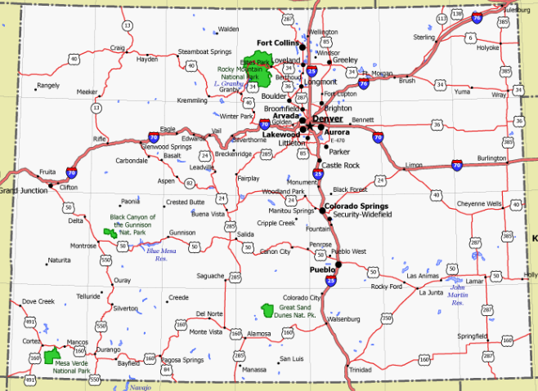



CHORDS: Colorado Health Observation Regional Data Service
  Data Partners
  14 health care providers and
  2 community-based organizations (CBOs)
  Data Users
  Researchers and public health agencies serving Colorado’s Front Range
  Goal
  Expanded use of electronic health record (EHR) data to support timely public health evaluation, monitoring and research efforts
Notes:
Nina
CHORDS is a distributed health data network that began more than a decade ago
It has grown to include 14 health providers, including three behavioral health providers, and thanks to the CODI collaboration, 2 CBOs
Covered approximately 40% of all children and 25% of all adults in the metro Denver region
Data users:
Used data for community health assessments, projects around specific conditions like obesity monitoring and prevention, COVID-related work
GOAL:
CHORDS uses a federated model where each data partner implements a common data model to their own virtual data warehouse rather than a central data repository
Queries are executed using a data mart client called PopMedNet, which is an open source tool from Harvard Pilgrim

Slide 16






CODI@CHORDS Partnership
Health Care Data Partners
Data Coordinating Center (DCC)
Community Data Partners
Notes:
Nina
Data Coordinating Center administers the data infrastructure and executes queries on behalf of partners

Slide 17
The Journey: CODI Integration Into CHORDS
2018-2020
Brought six CHORDS partners to collaborate on CODI: governance, data model, and data sharing
  Onboarded two community data partners
    Developed two childhood obesity projects around prevalence and dose/response
      Implemented a master data sharing agreement
        Identified an open-source method for PPRL (anonlink)
Notes:
Nina
2018-20
Brought six CHORDS partners together to collaborate on CODI: governance, data model, and data sharing
Onboarded two community data partners to CHORDS
Developed two childhood obesity projects around the prevalence of childhood obesity and dose-response: impact of weight management programs on health outcomes (BMI)
Implemented a master data sharing agreement
Identified an open-source method for PPRL (anonlink)
2021
Executed queries to create longitudinal datasets
Created a quality assurance (QA) process for the data model
Discovered errors in PPRL matching
Began engaging additional CODI partners (have not yet incorporated these partners’ data)
2022-23
Created QA process for PPRL
Re-ran record linkage with much improved results
Still to come:
Will be re-running queries and beginning analyses on data sets
Will be developing two publications on childhood obesity prevalence and the impact of weight management interventions on BMI (dose/response)

Slide 18
The Journey: CODI Integration Into CHORDS
2018-2020 2021
Executed queries to create longitudinal datasets
  Created a quality assurance (QA) process for the data model
    Discovered errors in PPRL matching
      Began engaging additional CODI partners (have not yet incorporated these partners’ data)
Notes:
Nina
2021
Executed queries on two use cases around to create longitudinal datasets
Created a quality assurance (QA) process for the data model
Discovered errors in PPRL matching
Began engaging additional CODI partners (have not yet incorporated these partners’ data)
2022-23
Created QA process for PPRL
Re-ran record linkage with much improved results
Still to come:
Will be re-running queries and beginning analyses on data sets
Will be developing two publications on childhood obesity prevalence and the impact of weight management interventions on BMI (dose/response)

Slide 19
The Journey: CODI Integration Into CHORDS
2018-2020 2021 2022-2023
Created QA process for PPRL
  Re-ran record linkage with much improved results
Still to Come…
Re-running queries and beginning analyses on data sets
  Developing two publications
Notes:
Nina
2021
Executed queries to create longitudinal datasets
Created a quality assurance (QA) process for the data model
Discovered errors in PPRL matching
Began engaging additional CODI partners (have not yet incorporated these partners’ data)
2022-23
Created QA process for PPRL
Re-ran record linkage with much improved results
Still to come:
Will be re-running queries and beginning analyses on data sets
Will be developing two publications on childhood obesity prevalence and the impact of weight management interventions on BMI (dose/response)

Slide 20

Challenges Accomplishments Learnings
Governance PPRL Partners
Challenges: Aligning CODI and CHORDS governance; length of time to execute agreements
Accomplishment: Master Data Sharing and Use Agreement
Keys to Success: Transparency and building on trusted relationships
Notes:
Nina
Governance
Challenge: Aligning CODI and CHORDS governance; length of time to execute agreements
Accomplishment: Master Data Sharing and Use Agreement
Keys to Success: Transparency and building on trusted relationships
PPRL
Challenge: Executing synchronous record linkage, especially with community partners; no methods to assure linkage quality
Accomplishment: Development of multi-site process flows and PPRL QA tools
Keys to Success: Adequate time and resources for QA; technical expertise
Partners
Challenge: Partner capacity, especially during the pandemic; maintaining VDWs
Accomplishment: Dedicated technical assistance for CBOs
Keys to Success: Engaging CBOs in symbiotic relationship with funding

Slide 21
Challenges Accomplishments Learnings
Governance PPRL Partners
Challenges: Executing synchronous record linkage, especially with community partners; no methods to assure linkage quality
Accomplishment: Development of multi-site process flows and PPRL QA tools
Keys to Success: Adequate time and resources for QA; technical expertise
Notes:
Nina
PPRL
Challenge: Executing synchronous record linkage, especially with community partners; no methods to assure linkage quality
Accomplishment: Development of multi-site process flows and PPRL QA tools
Keys to Success: Adequate time and resources for QA; technical expertise
Partners
Challenge: Partner capacity, especially during the pandemic; maintaining VDWs
Accomplishment: Dedicated technical assistance for CBOs
Keys to Success: Engaging CBOs in symbiotic relationship with funding

Slide 22
Challenges Accomplishments Learnings
Governance PPRL Partners
Challenges: Partner capacity, especially during the pandemic; maintaining VDWs
Accomplishment: Dedicated technical assistance for CBOs
Keys to Success: Engaging CBOs in symbiotic relationship with funding
Notes:
Nina
Partners
Challenge: Partner capacity, especially during the pandemic; maintaining VDWs
Accomplishment: Dedicated technical assistance for CBOs
Keys to Success: Engaging CBOs in symbiotic relationship with funding

Slide 23








SDOH Data Integration
Intervention
Screening
Goal setting
Food Assistance
Clinical Organizations
SDOH
Individual
Family
Population
Community Based Organizations
Diagnosis
Financial Assistance
Screening
Housing Stability
Notes:
Emily
CODI takes a broad view of SDOH
Incorporating diverse SDOH data from clinical and community based organizations is essential to understand the multifaceted ways in which the conditions in the places where people live, learn, work, and play that affect a wide range of health and quality-of life-risks and outcomes
The process of defining, integrating, and standardizing SDOH data is often more complicated than the clinical metrics we’re used to sharing
Emily – this is from Lura:
can we talk about some of the SDOH work, specifically how successful CODI implementation improves communities’ and public health’s use of data to inform decisions that improve health and expand understanding of social determinants of health (SDOH) and how they shape health and health outcomes.

Slide 24
Experiences Incorporating SDOH Data
Health Systems
  Surveyed partners about existing SDOH data
  Adapted data model for different partners and populations
  Incorporated health system interventions
  Technical environmental scan
  Enthusiasm to participate and generate trust
  Established a technical partnership
Community-Based Organizations
Comprehensive Governance
Notes:
Emily
Health care partners include a large safety net health system, a large HMO, and a large children’s hospital and its associated network
CBOs include an after school running program for girls and an organization that connects tens of thousands of Coloradans to food-related resources
There are opportunities for symbiotic benefit

Slide 25
Standardizing and Sharing Data: Challenges
QA on health system SDOH data
  Adjusting to system-specific screening tools
Capturing populations with adequate data over time
Addressing technological limitations
  Generating unique identifiers
  Standardizing location data
  Missing data across key variables
Notes:
Emily
Expand existing QA
Variation in data collection over time
Sometimes not usable
Capturing a population with adequate data:
HFC: pediatric population w/ referrals bc of household-level data
GOTR: attendance records only captured 40-50% of attendance
Health systems: SDOH screening for specific populations
Generating unique IDs
- GOTR:

Slide 26
Standardizing and Sharing Data: Opportunities
Automating processes
Sharing technology
Taking advantage of a flexible data model
Collaborating with new partners
  Health information exchanges
  Other distributed data networks and social services
Building out diverse public health use cases
Finding common ground and symbiotic benefits of data sharing
Notes:
Emily
Automating processes
Sharing technology
Taking advantage of a flexible data model
Collaborating with new partners
Health information exchanges
Other distributed data networks and social services
Building out diverse public health use cases
Finding common ground and symbiotic benefits of data sharing

Slide 27
Next Steps
Project Completion
CHORDS to complete current CODI pilot in late 2023
Future Opportunities
Onboard new partners and expand data to adults
Include referrals to direct delivery of assets
Develop reporting mechanisms relevant to community partners
Continue to develop data tools for public health research
Notes:
Emily
CHORDS will complete the CODI pilot across three health care organizations and two community partners in 2023
Future opportunities:
Onboard new community and health care partners and expand data to adults
Add tables to the data model to include referrals between organizations and services and direct delivery of assets such as money or food.
Develop reporting mechanisms directly relevant to community partners
Continue to develop data tools for public health monitoring and research

Slide 28
Resources
SDOH Data Report: Incorporating Social Determinants of Health Data from Health Care Partners and Community-Based Organizations into a Common Data Architecture
PPRL QA Report: Initial Quality Assessment of the Privacy-Preserving Record Linkage Process in a Distributed Data Network of Health Care and Community Partners
CHORDS Website
CHORDS Infrastructure (manuscript)
CODI Website
CODI Case Study (manuscript)
Contacts:
Emily Bacon: baconanalyticsco@gmail.com
Nina Bastian: bastiann@coloradohealthinstitute.org
Notes:
Emily
We hope to update the PPRL QA report with findings from our final step – PII review between two health care data partners.

Slide 29
CODI NC
Sarah Armstrong, MD – Professor of Pediatrics and Population Health Sciences, Duke University School of Medicine
Stephanie Poley, PhD – Duke Clinical Research Institute

Slide 30
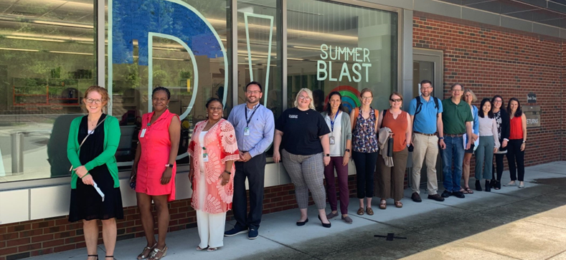
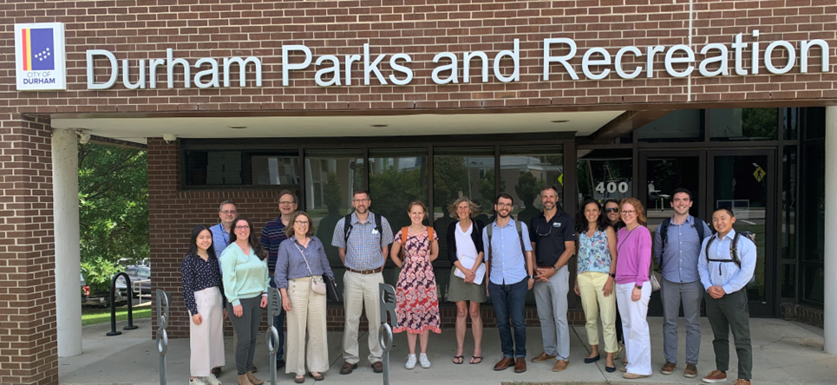
Engaging Partners & Building Trust
Partner engagement was locally led
Evaluated 38 community organizations and 20 clinical programs through an initial Programmatic Environmental Scan (PES)
Engaged 34 organizations for CODI introductions
Currently partnered with 5 community and 2 clinical organizations
Learned about the local value and priorities CODI can support in Triangle region as well as current barriers partners are facing
Developed relationships/connections at the local and state level and built network trust by:
  focusing on local priorities
  encouraging collaborative decision-making and problem-solving via the CODI Collaborative Workgroup
  providing technical support for implementation
Notes:
Sarah

Slide 31
CODI NC Partners
Government/Community Orgs
Special Supplemental Nutrition Program for Women, Infants, and Children
NC HealthConnex
Government Data Analytics Center (GDAC)
NC Department of Health & Human Services (DHHS)
Root Causes
Farmer Foodshare
Durham’s Innovative Nutrition Education (DINE)
Clinical Orgs
Piedmont Health
Lincoln Community Health Center
Related Initiatives
Integrated Care for Kids (InCK)
NCCARE360
Other ENGAGED Organizations
Parks & Rec – Chapel Hill
Parks & Rec – Durham
YMCA of the Triangle
NC Coalition to End Homelessness
Durham County Department of Public Health
Duke University Health System
University of North Carolina Health System
CURRENT PARTNERS

Slide 32
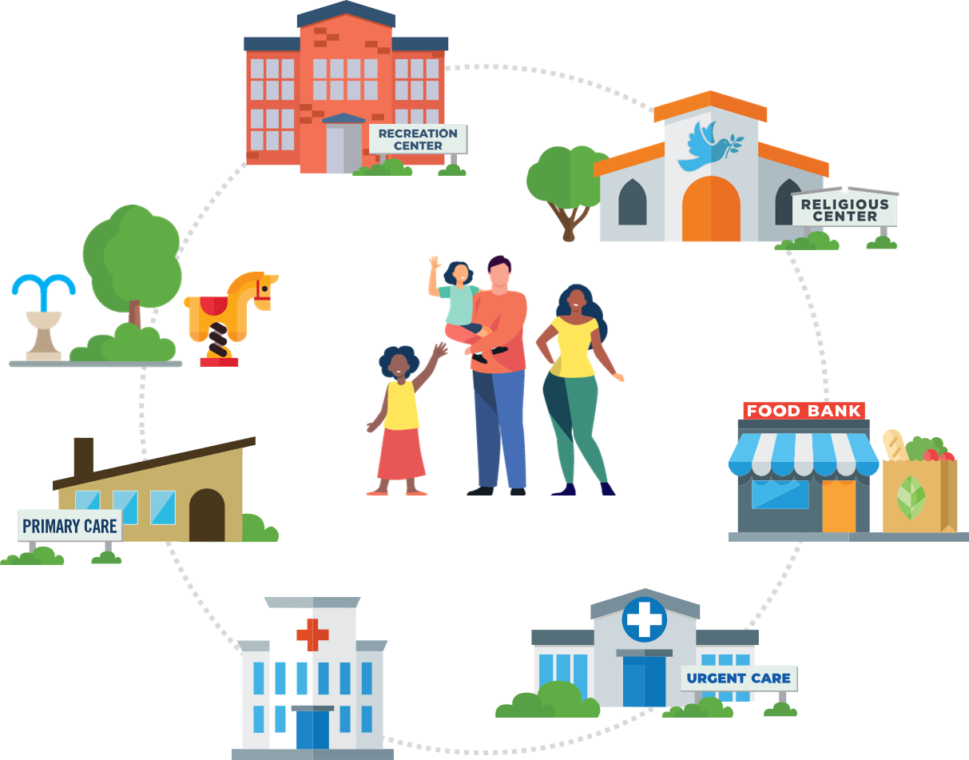
CODI Value
Available clinical & community data will help organizations better design their programs to meet community needs and improve impact
CODI can inform the development of wraparound services aimed at addressing SDOH
Outcomes data will be useful in drafting justifications for organizational work and securing funding
The Collaborative is a helpful forum to share program ideas across organizations and build local relationships
The CODI infrastructure will help organize partner data to be readily available to respond to data sharing requests
Notes:
Sarah

Slide 33
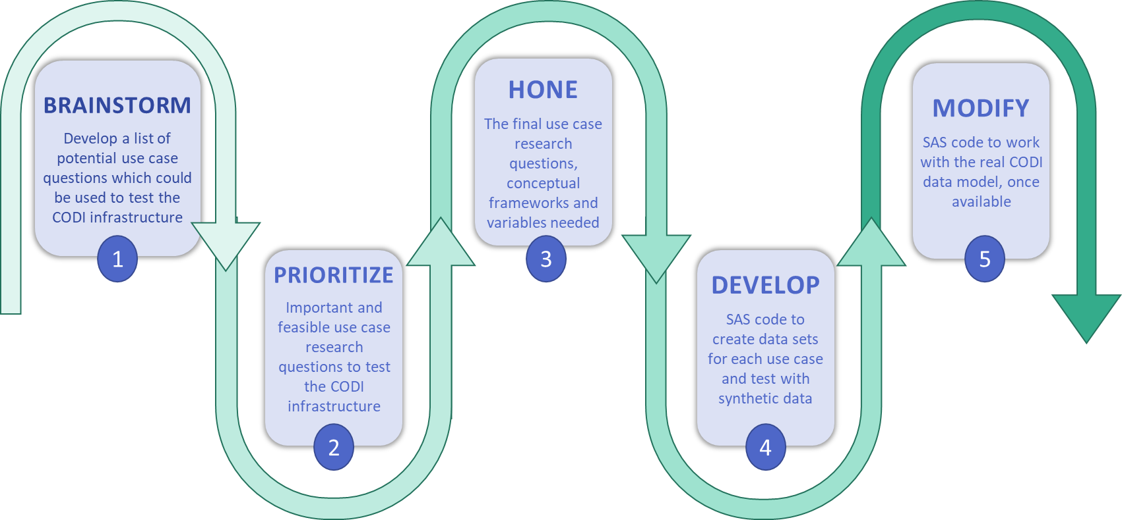
CODI@NC Use Cases
Notes:
Sarah

Slide 34
CODI@NC Use Cases
What are the characteristics* of the population served by each CODI-participating organization/program?
*characteristics = demographic, geographic, SDOH, or health-related
Is enrollment in a program associated with a change in health outcomes such as BMI, HbA1C, or BP?
What follow-up steps* do BMI or risk assessment trigger?
* follow-up steps = labs & tests, actions & referrals, programs
Notes:
Sarah

Slide 35
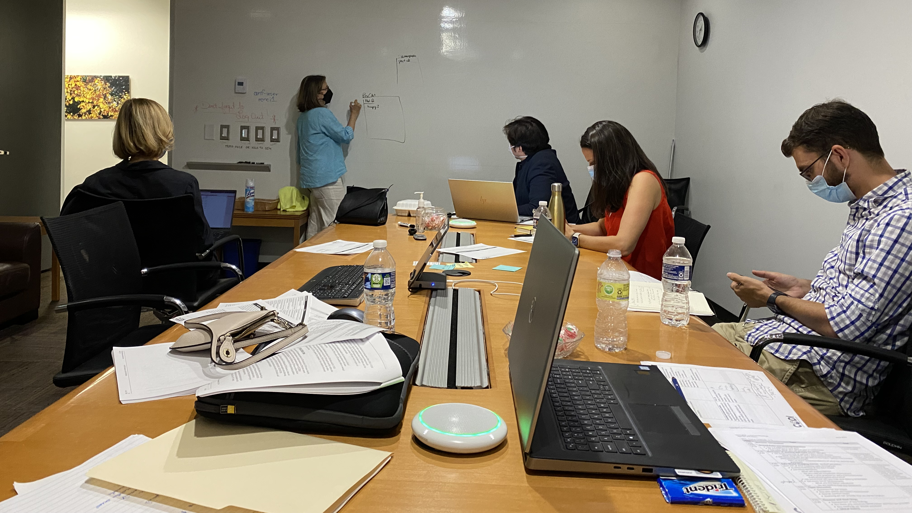
Technical Implementation
Meeting our partners where they’re at
  1:1 implementation meetings with each partner is key
  Provide funding support and a Data Partner for community organizations
Governance agreements for data sharing are key dependencies for technical implementation
Testing processes, such as PPRL implementation, helps to identify challenges early on and improve quality
Notes:
Stephanie

Slide 36

Where are we?
Onboarded 2 clinical & 3 community partners
Drafted governance agreements
Conducted technical assessments
Developed use cases and drafted query code to pull data
Reviewing governance agreements
Testing privacy preserving record linkage solution
Mapping partner data to the CODI Data Model
Planning for network sustainability
Execute the governance agreements
Run a use case query to create a longitudinal dataset
Convene a governing body
Develop a business plan
Onboard new partners
Notes:
Stephanie

Slide 37
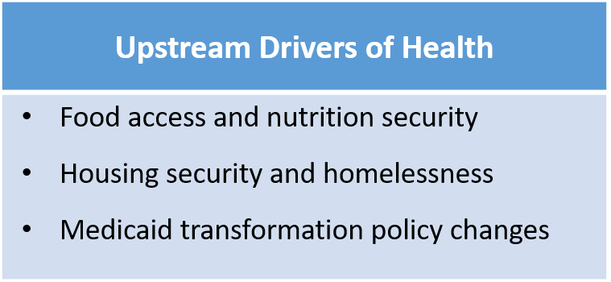
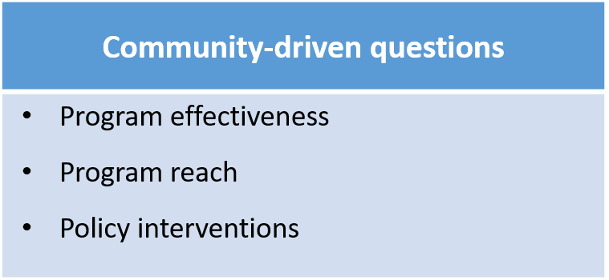
Where are we going?
CODI is intended to be a community-driven research network for child and family health that addresses:
What is CODI@NC’s vision?
Growth opportunities/what’s next
  Business model
  Geographic expansion
  Governance – where could this live?
Notes:
Stephanie

Slide 38
Discussion

Slide 39
Discussion
How do we grow the network?
What are other applications of the CODI infrastructure?
What are sustainability solutions for networks and initiatives such as these at local, state level?

Slide 40
Thank you!
Please email CODI@cdc.gov with questions.

